Slide 1
FIGHT AGAINST COVID-19
COA PROJECT
- SHACHI INTODIA (2K19/CO/350)
- SHIKHAR CHAUHAN (2K19/CO/359)

Slide 2
INTRODUCTION
Coronavirus disease 2019 (COVID-19), also known as the coronavirus or COVID, is a contagious disease which can be easily spread from person to person if not taken appropriate precautions. The main idea behind creating this project is to prevent the spread of COVID-19.
Keeping in mind the seriousness of the novel Corona virus and the preventive measures to be taken to avoid the spread of the virus, we have come up with two innovative circuits – ‘The Smart Social Distancing Indicator and Alarming System’ and ‘The Smart Disinfection and Sanitation Tunnel’.
These circuits can be used in various industries and will prove to be of great help in these challenging times of pandemic.

Slide 3
SOCIAL DISTANCING INDICATOR AND ALARMING SYSTEM
The Smart Social Distancing Indicator and Alarming System will come in handy to keep the 6 feet distance amongst each other. The circuit will give auditory as well as visual signals and warnings when a person is in close proximity.

Slide 4
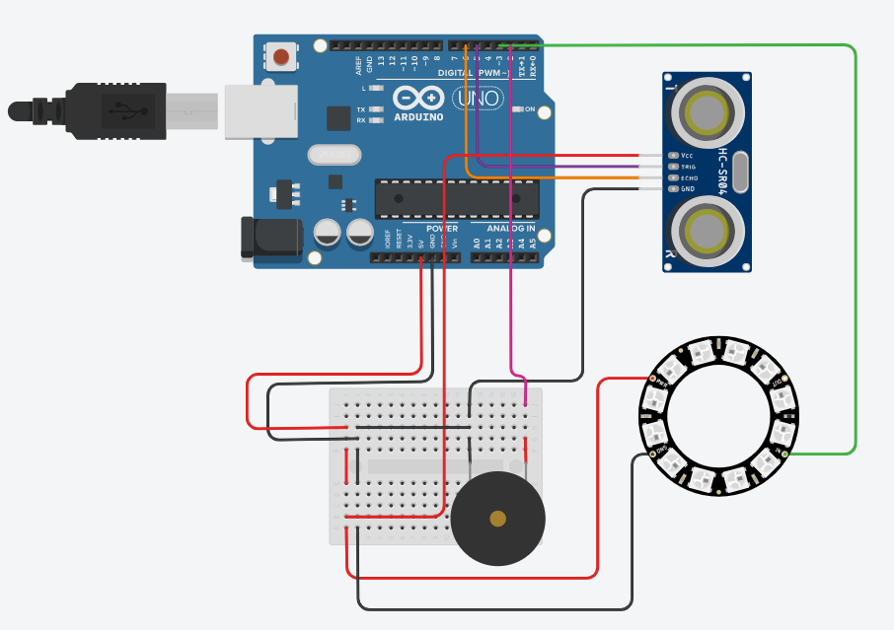
CIRCUIT
Ultrasonic Distance Sensor
Arduino
Uno R3
Neo Pixel
Ring -12
Buzzer
Simulation Link : https://www.tinkercad.com/things/lOKyEKdpwga

Slide 5
PRINCIPLE
Number of LEDs glow up corresponding to the distance measured
If number of LEDs glowing is equal to 12, then the buzzer starts ringing
The ultrasonic distance sensor measures the distance

Slide 6
WORKING OF ULTRASONIC SENSOR
It all starts, when a pulse of at least 10 µS (10 microseconds) in duration is applied to the Trigger pin. In response to that the sensor transmits a sonic burst of eight pulses at 40 KHz. This 8-pulse pattern makes the “ultrasonic signature” from the device unique, allowing the receiver to differentiate the transmitted pattern from the ambient ultrasonic noise.
The eight ultrasonic pulses travel through the air away from the transmitter. Meanwhile the Echo pin goes HIGH to start forming the beginning of the echo-back signal.
In case, If those pulses are not reflected back then the Echo signal will timeout after 38 mS (38 milliseconds) and return low. Thus a 38 mS pulse indicates no obstruction within the range of the sensor.
If those pulses are reflected back the Echo pin goes low as soon as the signal is received. This produces a pulse whose width varies between 150 µS to 25 mS, depending upon the time it took for the signal to be received.
The width of the received pulse is then used to calculate the distance to the reflected object.
Distance = Speed of Sound X (Time/2)
Distance = Time / (29 * 2)
Distance = (Time µS * 0.034 cm/µS) / 2

Slide 7
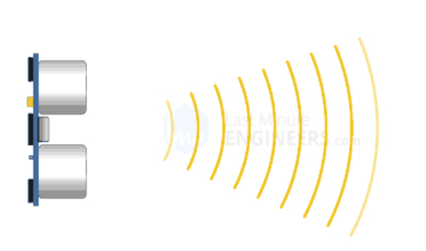
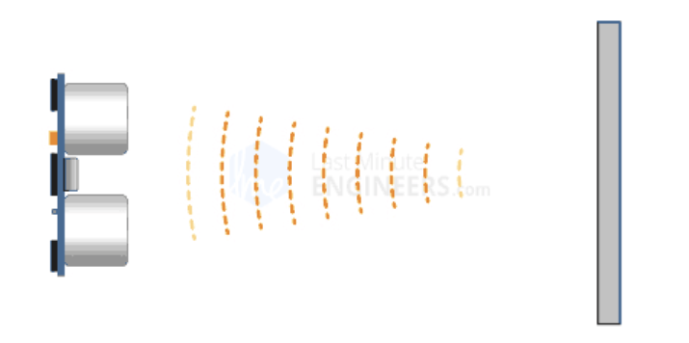
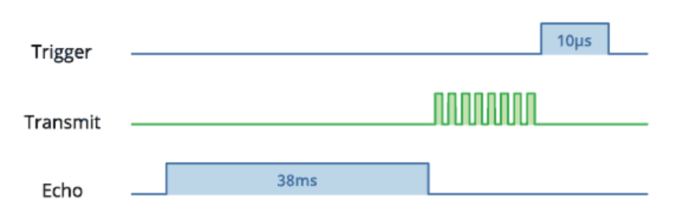
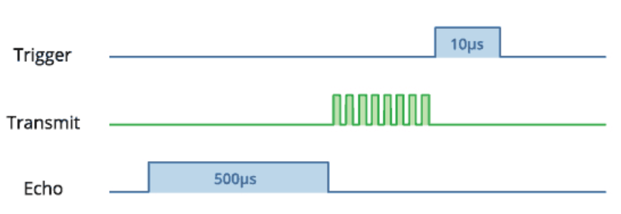
WORKING OF ULTRASONIC SENSOR
If there is no obstruction, pulses are not reflected back and Echo signal will timeout after 38 mS
In case of an obstruction, pulses are reflected back and the Echo pin goes low. The pulse width varies between 150 µS to 25 mS

Slide 8
WORKING OF CIRCUIT
The connections are made according to the circuit diagram shown above. The Arduino Uno board is connected with a PC using a USB cable. The code written in Arduino Uno IDE is loaded into the Arduino Uno board.
The ultrasonic sensor transmits 8 ultrasonic pulses that travel through the air away from the transmitter. If the pulses are reflected back, the ECHO pin goes low. The distance is measured using the time it took for the reflected pulses to be received.
Based on the distance detected by the ultrasonic sensor, corresponding number of LEDs light up in the NeoPixel ring. The color of the LEDs indicate the proximity of a person.
When the distance detected by the ultrasonic sensor is less than 100 meters, all the 12 LEDs of the neopixel ring light up and this causes the piezo buzzer pin to get a HIGH input and thus the buzzer starts ringing giving an auditory indicator to maintain a safe distance.

Slide 9
DISTANCE MEASURED BY SENSOR
Distance > 300 meters (SAFE)
300 > Distance > 233 meters (SAFE)
233 > Distance > 167 meters (WARNING)
167 > Distance > 100 meters (DANGER)
Distance < 100 meters (DANGER) (BUZZER RINGS)

Slide 10

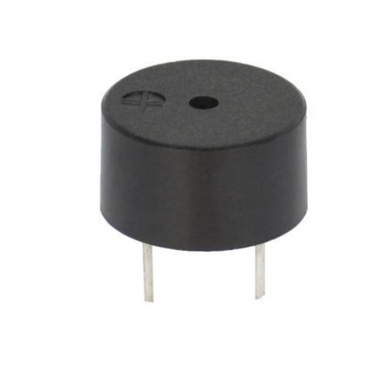
INDICATORS
RED - DANGER
YELLOW - WARNING
GREEN - SAFE
NeoPixel Ring
Buzzer

Slide 11
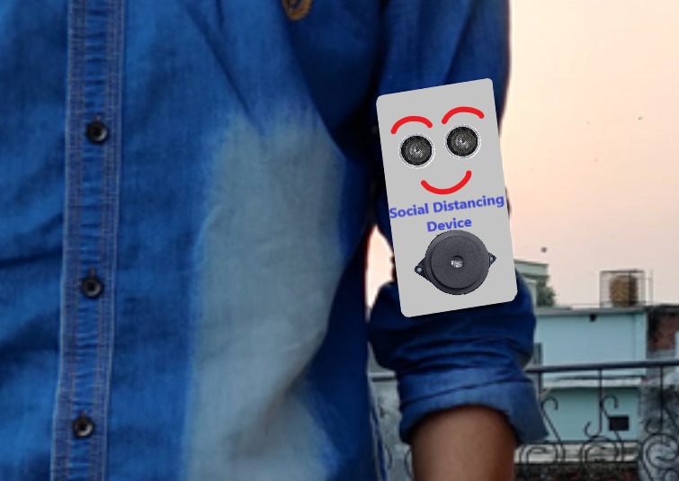
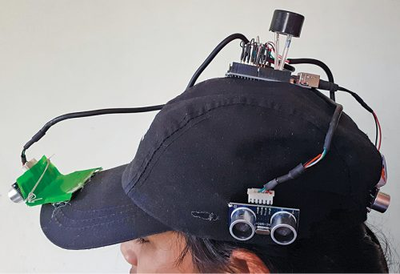
PRACTICAL USE
Social Distancing Alarm Band
Social Distancing Alarm Cap

Slide 12
SMART DISINFECTION AND SANITIZATION TUNNEL
The Smart Disinfection and Sanitation Tunnel is a demonstration of how to provide maximum protection to people passing through the sanitization tunnel in around 15 seconds which can help the community to fight against the COVID-19.

Slide 13
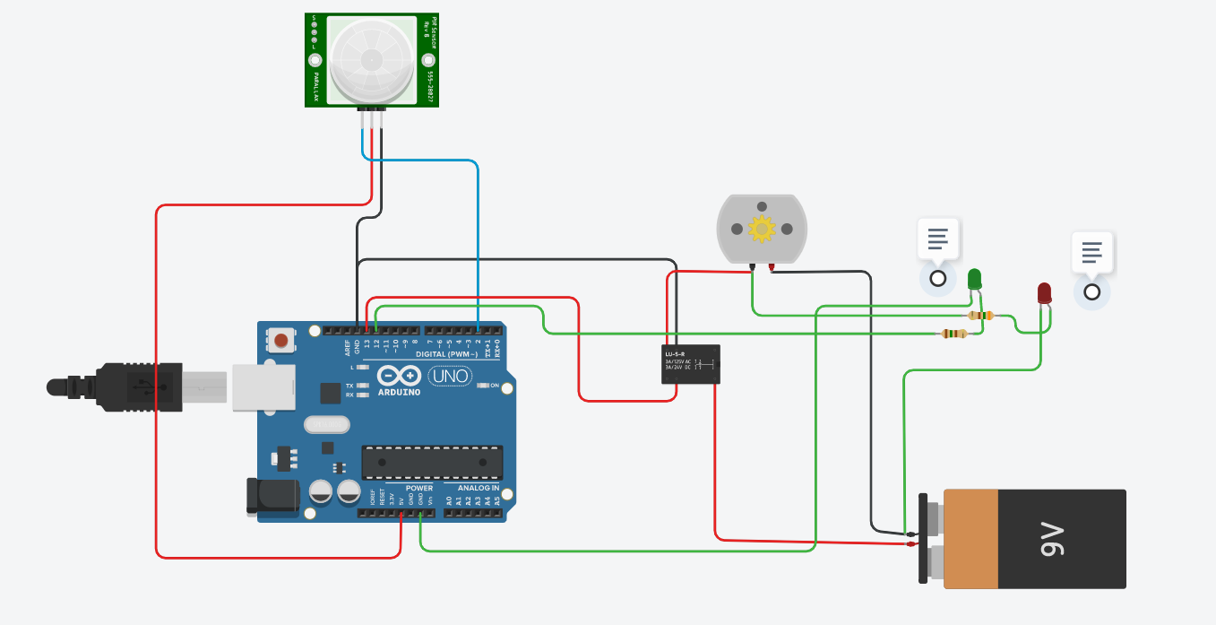
CIRCUIT
PIR Sensor
DC Motor
LEDs
Resistors
SPDT Relay
Battery
Arduino
Uno R3
Simulation Link : https://www.tinkercad.com/things/017JDFz03aD

Slide 14
PRINCIPLE
If a person is detected, the DC motor starts turning. The red LED glows indicating that the sanitizer is being sprayed and that the tunnel is occupied.
After a delay of 5000 µs, the green LED glows indicating that the person is sanitized and can step out and the tunnel is now free for the next person to enter.
The green LED glows indicating that the tunnel is free for a person to enter.
The PIR sensor detects whether a person has entered the tunnel

Slide 15
WORKING OF PIR SENSOR
PIR sensors allow you to sense motion, almost always used to detect whether a human has moved in or out of the sensors range.
PIRs are basically made of a pyroelectric sensor, which can detect levels of infrared radiation.
Everything emits some low level radiation, and the hotter something is, the more radiation is emitted. That’s where the name of the sensor comes from, a Passive Infra-Red sensor. And the term “passive” means that sensor is not using any energy for detecting purposes, it just works by detecting the energy given off by the other objects.
The module also consists a specially designed cover named Fresnel lens, which focuses the infrared signals onto the pyroelectric sensor.

Slide 16
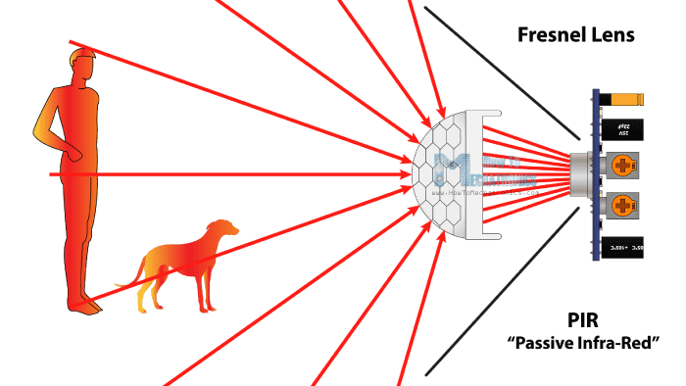
WORKING OF PIR SENSOR

Slide 17
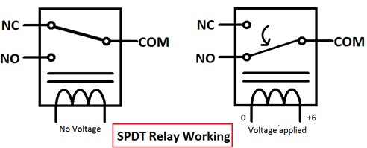
SPDT RELAY
Relay is an electromagnetic switch, which is controlled by small current, and used to switch ON and OFF relatively much larger current. Means by applying small current we can switch ON the relay which allows much larger current to flow.
A relay is a good example of controlling the AC (alternate current) devices, using a much smaller DC current.
Commonly used Relay is Single Pole Double Throw (SPDT) Relay, which has five terminals.
When there is no voltage applied to the coil, COM (common) is connected to NC (normally closed contact). When there is some voltage applied to the coil, the electromagnetic field produced, which attracts the Armature (lever connected to spring), and COM and NO (normally open contact) gets connected, which allow a larger current to flow.

Slide 18
WORKING OF CIRCUIT
The connections are made according to the circuit diagram shown above. The Arduino Uno board is connected with a PC using a USB cable. The code written in Arduino Uno IDE is loaded into the Arduino Uno board.
When a person comes in the range of the PIR sensor, it will detect a movement because the human body emits heat energy in a form of infrared radiation. This will give HIGH signal in the signal pin of PIR sensor.
When the Arduino input pin receives HIGH signal from PIR sensor, voltage is applied across the coil of the SPDT relay. The magnetic field produced attracts the armature from NC pin to NO pin and hence COM and NO gets connected, which allows a larger current to flow to the DC motor.
This activates the DC motor (that leads to sanitizer being sprayed) and hence the red LED glows.
After some delay, the relay is given LOW input and the green LED is given HIGH signal indicating the tunnel is free and the next person can enter.

Slide 19
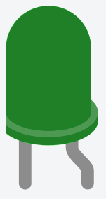
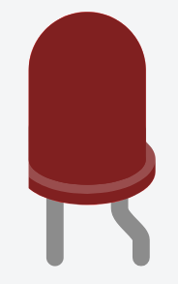
TUNNEL INDICATORS
ENTER
STOP

Slide 20
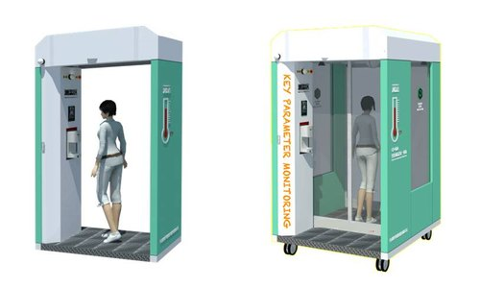
PRACTICAL USE
The smart disinfection and sanitization tunnel can be used in public places to avoid the spread of virus.
Food markets
Offices
Shopping malls
Airports
Bus stops
Railway stations
Police stations
College
Hospitals
Colony

Slide 21
THANK YOU
SHACHI INTODIA
SHIKHAR CHAUHAN

